Slide 1

ISE 218: Fundamentals of Information Technology Unit 9: Performance Measurement and Analysis
Spring 2025
Instructor: Abid Malik
co-Instructor: Xinrui Yu

Slide 2
Introduction
The ideas presented in this Unit will help you to understand various measurements of computer performance.
You will be able to use these ideas when you are purchasing a large system, or trying to improve the performance of an existing system.
We will discuss a number of factors that affect system performance, at both the software and hardware level.

Slide 3
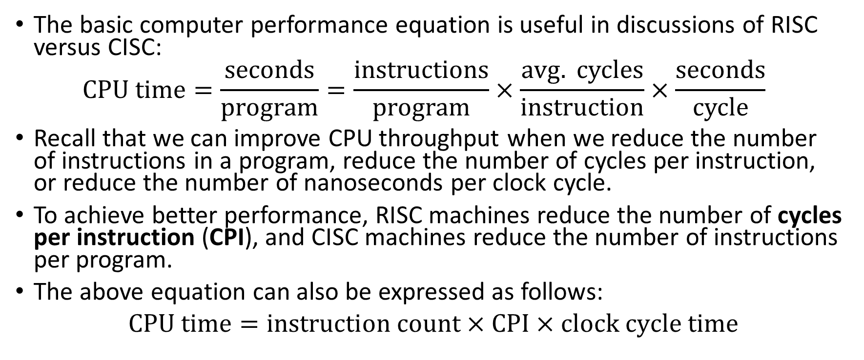
The Basic Computer Performance Equation
The basic computer performance equation is useful in discussions of RISC versus CISC:
$$CPU time=\frac{seconds}{program}=\frac{instructions}{program}×\frac{avg. cycles}{instruction}×\frac{seconds}{cycle}$$
Recall that we can improve CPU throughput when we reduce the number of instructions in a program, reduce the number of cycles per instruction, or reduce the number of nanoseconds per clock cycle.
To achieve better performance, RISC machines reduce the number of cycles per instruction (CPI), and CISC machines reduce the number of instructions per program.
The above equation can also be expressed as follows:
$CPU time=instruction count×CPI×clock cycle time$

Slide 4
Improving System Performance
To increasing overall system performance, we have the following options:
CPU optimization: maximize the speed and efficiency of operations performed by the CPU (the performance equation addresses this optimization).
Memory optimization: maximize the efficiency of a code’s memory management.
I/O optimization: maximize the efficiency of input/output operations.
An application whose overall performance is limited by one of these (CPU, memory usage, I/O operations) is said to be CPU bound, memory bound, or I/O bound, respectively
Hardware designers can directly influence CPU, memory and I/O performance, but software developers can also impact on all three by writing good (or bad) code

Slide 5
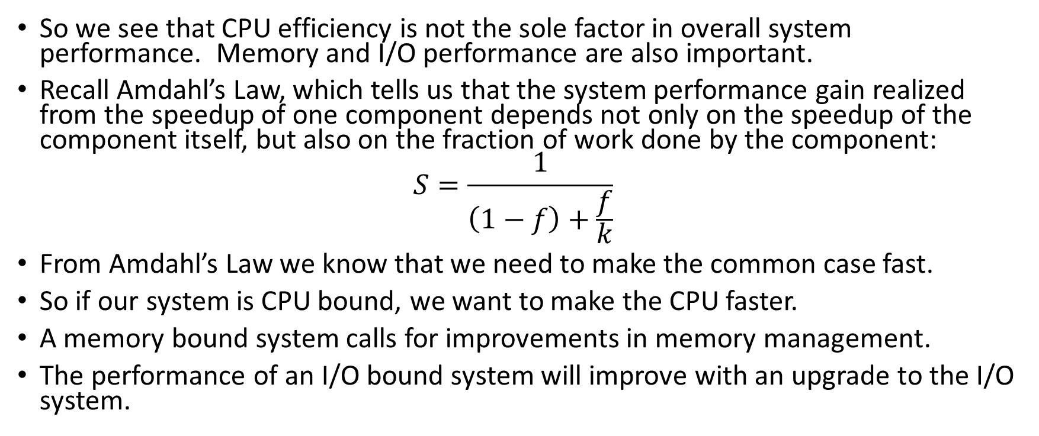
The Basic Computer Performance Equation
So we see that CPU efficiency is not the sole factor in overall system performance. Memory and I/O performance are also important.
Recall Amdahl’s Law, which tells us that the system performance gain realized from the speedup of one component depends not only on the speedup of the component itself, but also on the fraction of work done by the component:
$$S=\frac{1}{\left(1−f\right)+\frac{f}{k}}$$
From Amdahl’s Law we know that we need to make the common case fast.
So if our system is CPU bound, we want to make the CPU faster.
A memory bound system calls for improvements in memory management.
The performance of an I/O bound system will improve with an upgrade to the I/O system.

Slide 6
Measures of System Performance
Measures of system performance depend upon one’s point of view.
A computer user is most often concerned with response time: How long does it take the system to carry out a task?
System administrators are usually more concerned with throughput: How many concurrent tasks can the system handle before response time is adversely affected?
These two ideas are related: If a system carries out a task in k seconds, then its throughput is 1/k of these tasks per second.

Slide 7
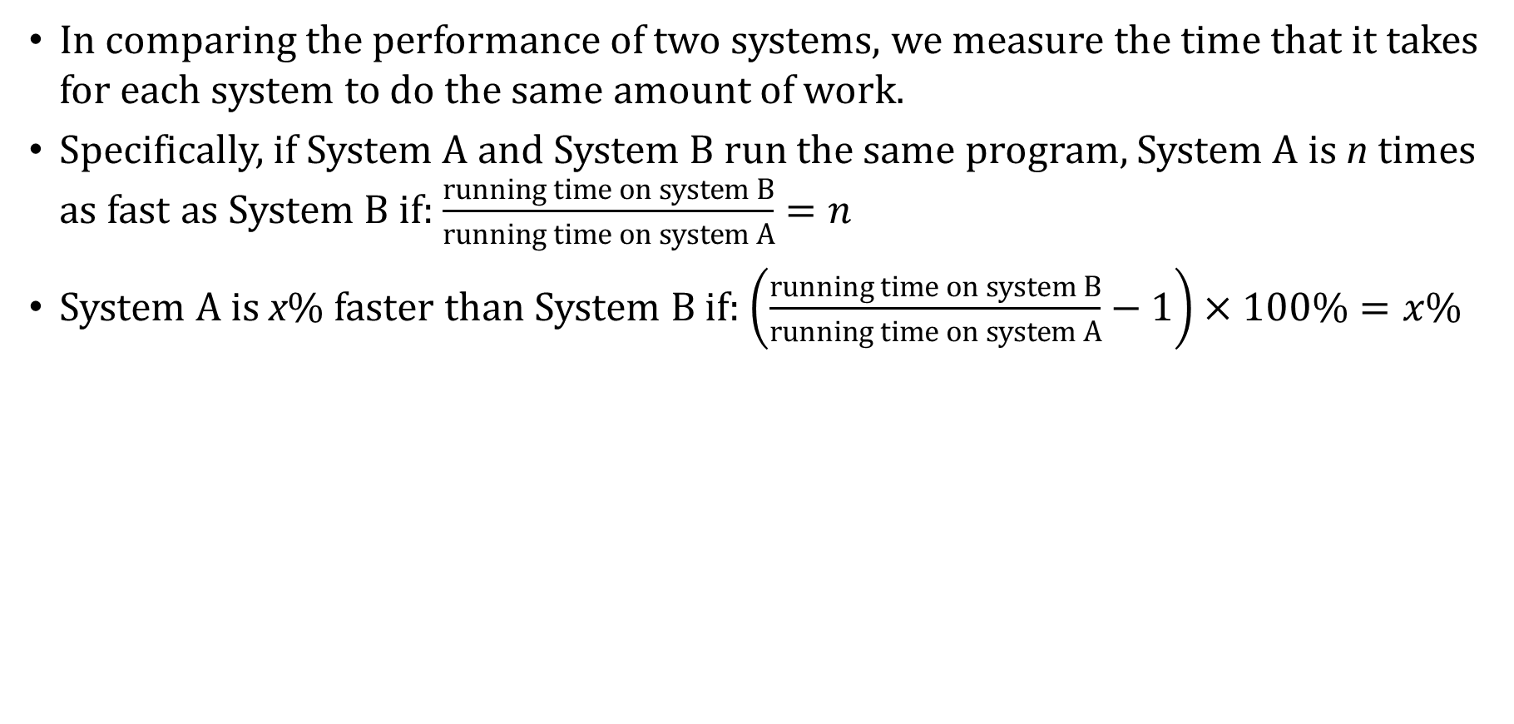
Measures of System Performance
In comparing the performance of two systems, we measure the time that it takes for each system to do the same amount of work.
Specifically, if System A and System B run the same program, System A is n times as fast as System B if: $\frac{running time on system B}{running time on system A}=n$
System A is x% faster than System B if: $\left(\frac{running time on system B}{running time on system A}−1\right)×100\%=x\%$

Slide 8
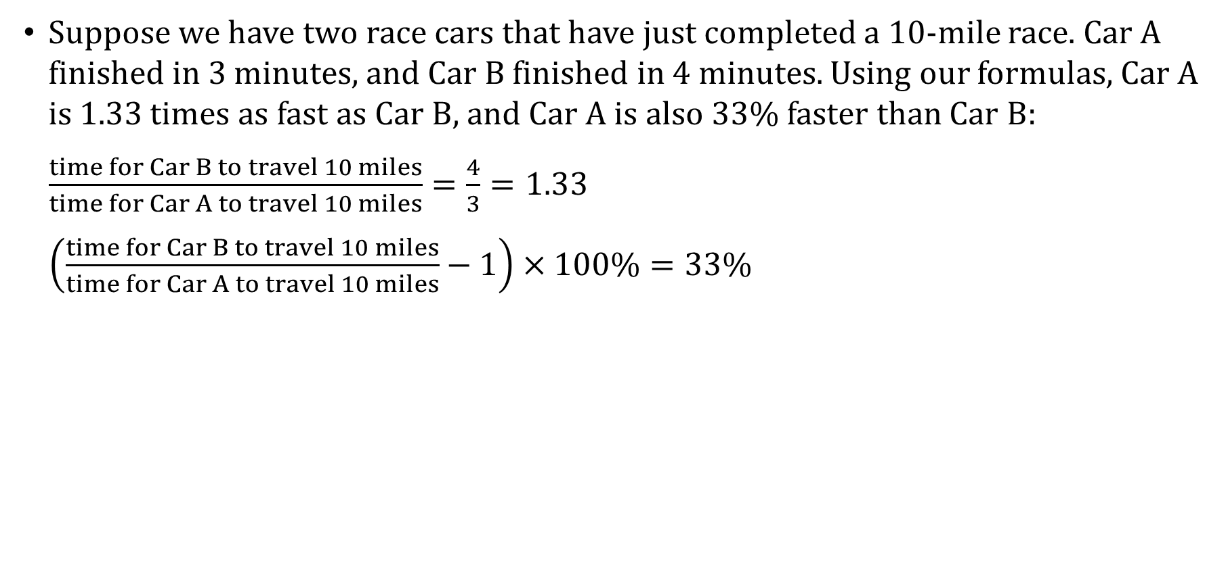
Measures of System Performance: Example #1
Suppose we have two race cars that have just completed a 10-mile race. Car A finished in 3 minutes, and Car B finished in 4 minutes. Using our formulas, Car A is 1.33 times as fast as Car B, and Car A is also 33% faster than Car B:
$\frac{time for Car B to travel 10 miles}{time for Car A to travel 10 miles}=\frac{4}{3}=1.33$
$\left(\frac{time for Car B to travel 10 miles}{time for Car A to travel 10 miles}−1\right)×100\%=33\%$

Slide 9
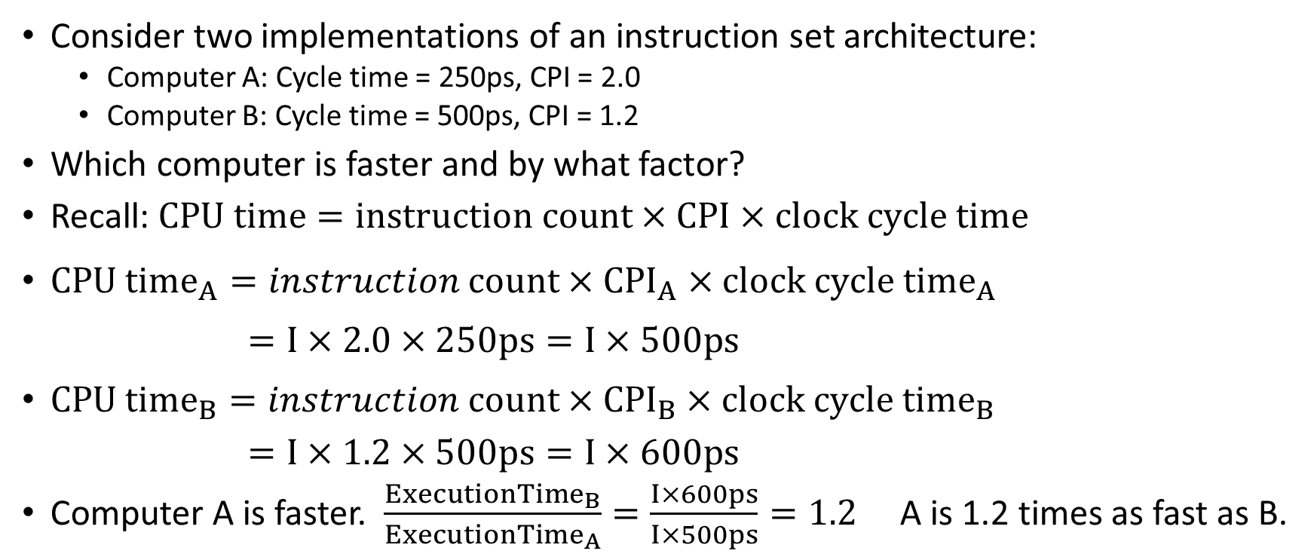
Measures of System Performance: Example #2
Consider two implementations of an instruction set architecture:
Computer A: Cycle time = 250ps, CPI = 2.0
Computer B: Cycle time = 500ps, CPI = 1.2
Which computer is faster and by what factor?
Recall: $CPU time=instruction count×CPI×clock cycle time$
${CPU time}_{A}=instruction count×{CPI}_{A}×{clock cycle time}_{A}$
$$=I×2.0×250ps=I×500ps$$
${CPU time}_{B}=instruction count×{CPI}_{B}×{clock cycle time}_{B}$
$=I×1.2×500ps=I×600ps$
Computer A is faster. $\frac{ExecutionTime_{B}}{{ExecutionTime}_{A}}=\frac{I×600ps}{I×500ps}=1.2$ A is 1.2 times as fast as B.

Slide 10
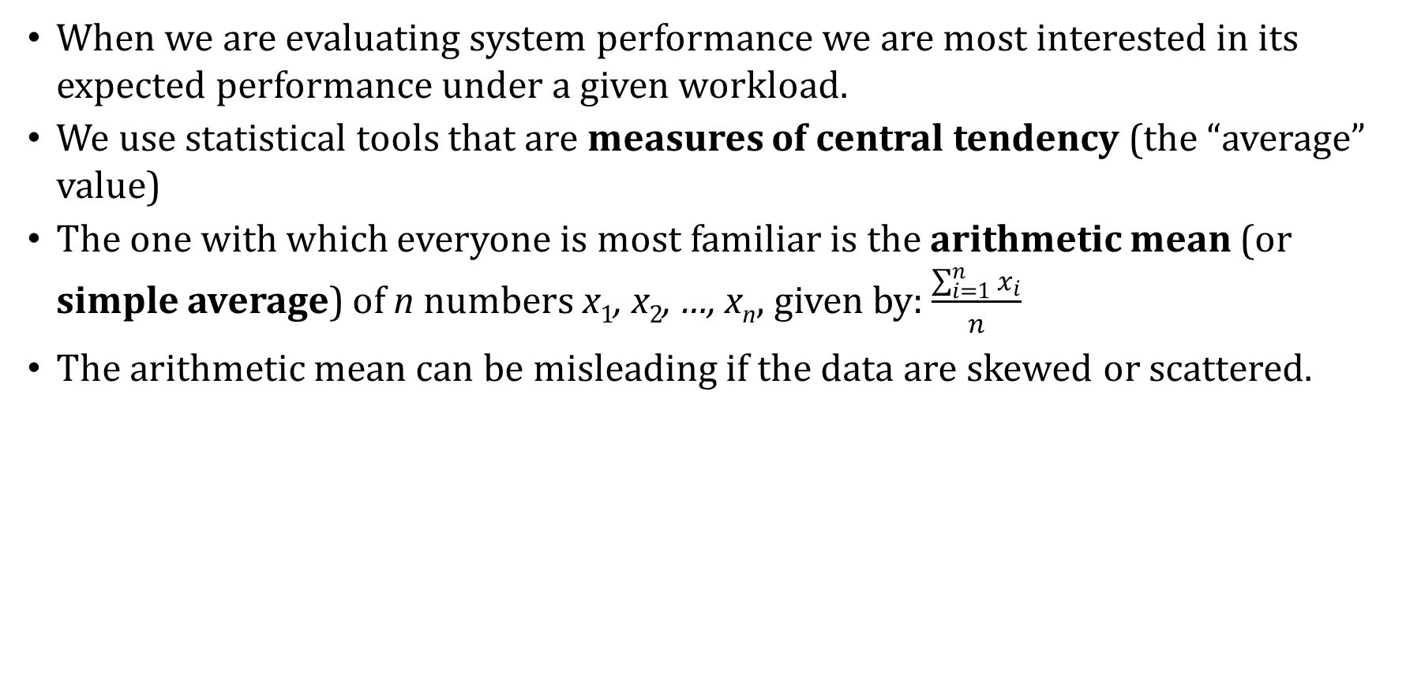
Measures of System Performance
When we are evaluating system performance we are most interested in its expected performance under a given workload.
We use statistical tools that are measures of central tendency (the “average” value)
The one with which everyone is most familiar is the arithmetic mean (or simple average) of n numbers x₁, x₂, …, x_{n}, given by:$\frac{\sum_{i=1}^{n}{x_{i}}}{n}$
The arithmetic mean can be misleading if the data are skewed or scattered.

Slide 11
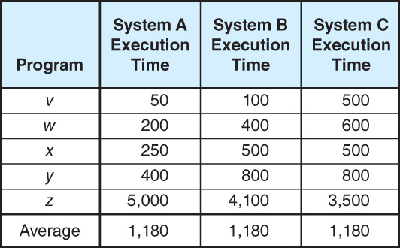
Measures of System Performance: Example #3
Consider the execution times given in the table below. The performance differences are hidden by the simple average.

Slide 12
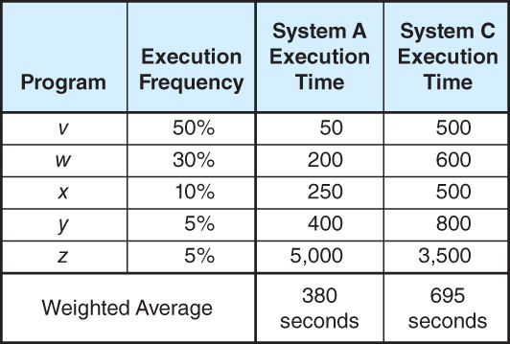
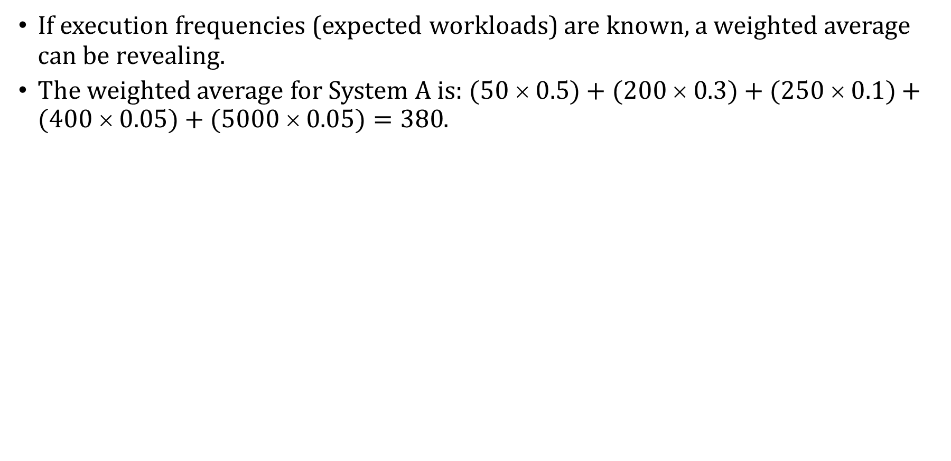
Measures of System Performance: Example #3
If execution frequencies (expected workloads) are known, a weighted average can be revealing.
The weighted average for System A is: $(50  0.5)+(200  0.3)+(250  0.1)+(400  0.05)+(5000  0.05)=380$.

Slide 13
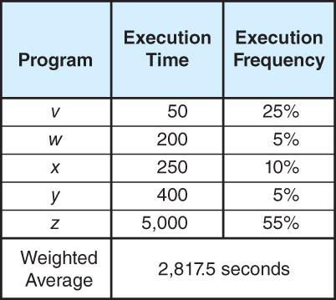
Measures of System Performance: Example #3
However, workloads can change over time.
A system optimized for one workload may perform poorly when the workload changes, as illustrated below.

Slide 14
Measures of System Performance
The objective assessment of computer performance is most critical when deciding which one to buy.
For enterprise-level systems, this process is complicated, and the consequences of a bad decision are grave.
Unfortunately, computer sales are as much dependent on good marketing as on good performance.
The wary buyer will understand how objective performance data can be slanted to the advantage of anyone giving a sales pitch.

Slide 15
Measures of System Performance
The most common deceptive practices in misrepresenting system performance include:
Selective statistics: citing only favorable results while omitting others.
Citing only peak performance numbers while ignoring the average case.
Vagueness in the use of words like “almost,” “nearly,” “more,” and “less,” in comparing performance data.
The use of inappropriate statistics or “comparing apples to oranges.”
Implying that you should buy a particular system because “everyone” is buying similar systems.

Slide 16
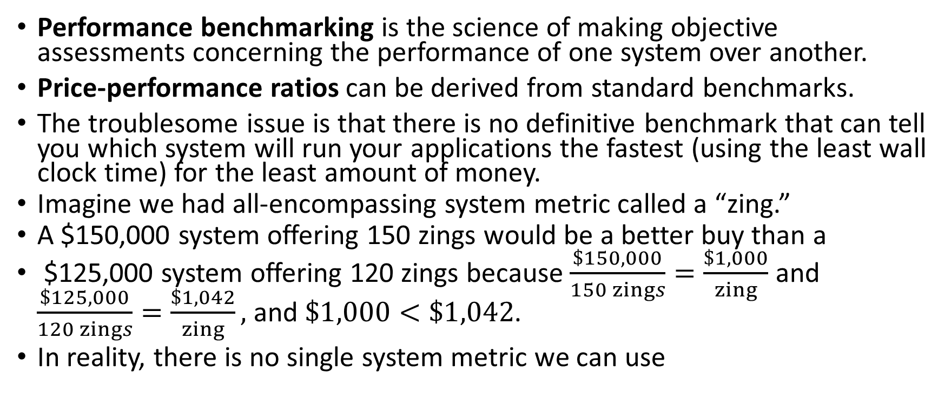
Benchmarking
Performance benchmarking is the science of making objective assessments concerning the performance of one system over another.
Price-performance ratios can be derived from standard benchmarks.
The troublesome issue is that there is no definitive benchmark that can tell you which system will run your applications the fastest (using the least wall clock time) for the least amount of money.
Imagine we had all-encompassing system metric called a “zing.”
A $150,000 system offering 150 zings would be a better buy than a
$125,000 system offering 120 zings because$\frac{\$150,000}{150 zings}=\frac{\$1,000}{zing}$ and $\frac{\$125,000}{120 zings}=\frac{\$1,042}{zing},$ and $\$1,000<\$1,042$.
In reality, there is no single system metric we can use

Slide 17
Benchmarking
Many people erroneously equate CPU speed with performance.
Measures of CPU speed include cycle time (MHz and GHz) and millions of instructions per second (MIPS).
Saying that System A is faster than System B because System A runs at 1.4GHz and System B runs at 900MHz is valid only when the instruction set architectures (ISAs) of Systems A and B are identical.
With different ISAs, it is possible that both of these systems could obtain identical results within the same amount of wall clock time.
Similar to MIPS is MFLOPS, Millions of Floating-point Operations per Second
MIPS and MFLOPS are not generally useful in comparing machines that have different architectures

Slide 18
Benchmarking
For example, to perform a given task, a typical RISC machine would execute more instructions than a typical CISC machine, and so have a higher MIPS or MFLOPS rating.
If both machines complete the task in one second, does that make the RISC machine faster? Not at all, no.
MIPS and MFLOPS could be useful in comparing relative performance across a line of similar computers offered by the same vendor
The assumption is that the underlying architectures are similar
Therefore, it is reasonable to conclude that a newer machine that offers 2x MIPS as the previous machine at less than 2x the price is actually a good buy

Slide 19
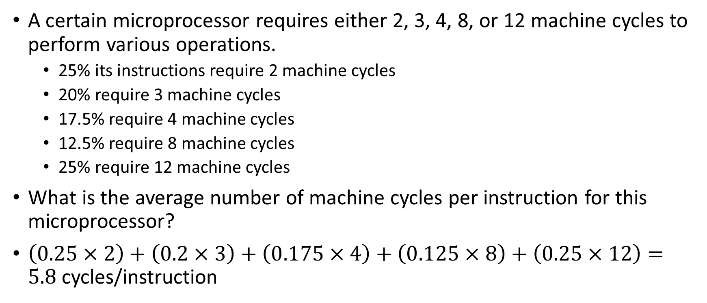
CPU Performance: Example
A certain microprocessor requires either 2, 3, 4, 8, or 12 machine cycles to perform various operations.
25% its instructions require 2 machine cycles
20% require 3 machine cycles
17.5% require 4 machine cycles
12.5% require 8 machine cycles
25% require 12 machine cycles
What is the average number of machine cycles per instruction for this microprocessor?
$\left(0.25×2\right)+\left(0.2×3\right)+\left(0.175×4\right)+\left(0.125×8\right)+\left(0.25×12\right)=$ $5.8$ cycles/instruction

Slide 20
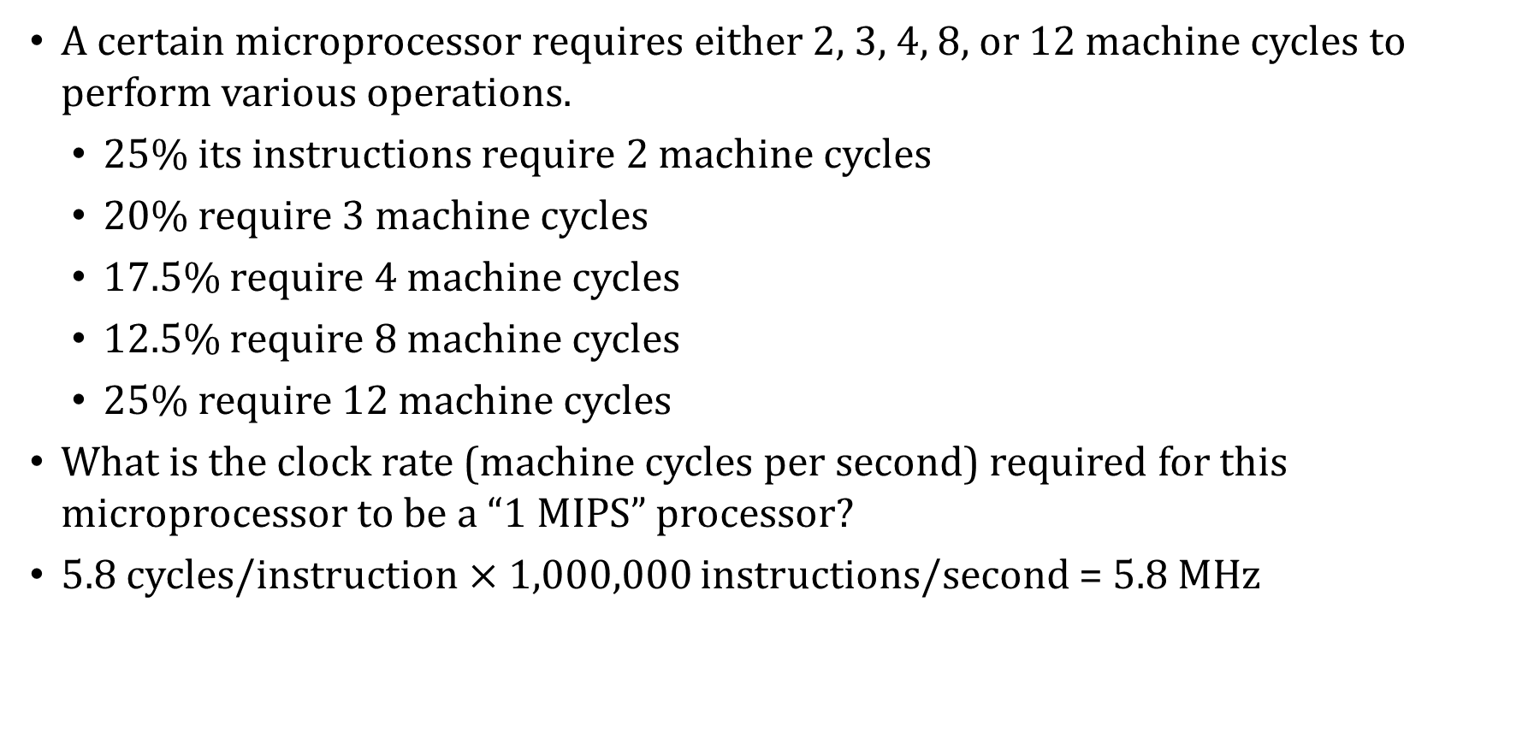
CPU Performance: Example
A certain microprocessor requires either 2, 3, 4, 8, or 12 machine cycles to perform various operations.
25% its instructions require 2 machine cycles
20% require 3 machine cycles
17.5% require 4 machine cycles
12.5% require 8 machine cycles
25% require 12 machine cycles
What is the clock rate (machine cycles per second) required for this microprocessor to be a “1 MIPS” processor?
5.8 cycles/instruction $×$ 1,000,000 instructions/second = 5.8 MHz

Slide 21
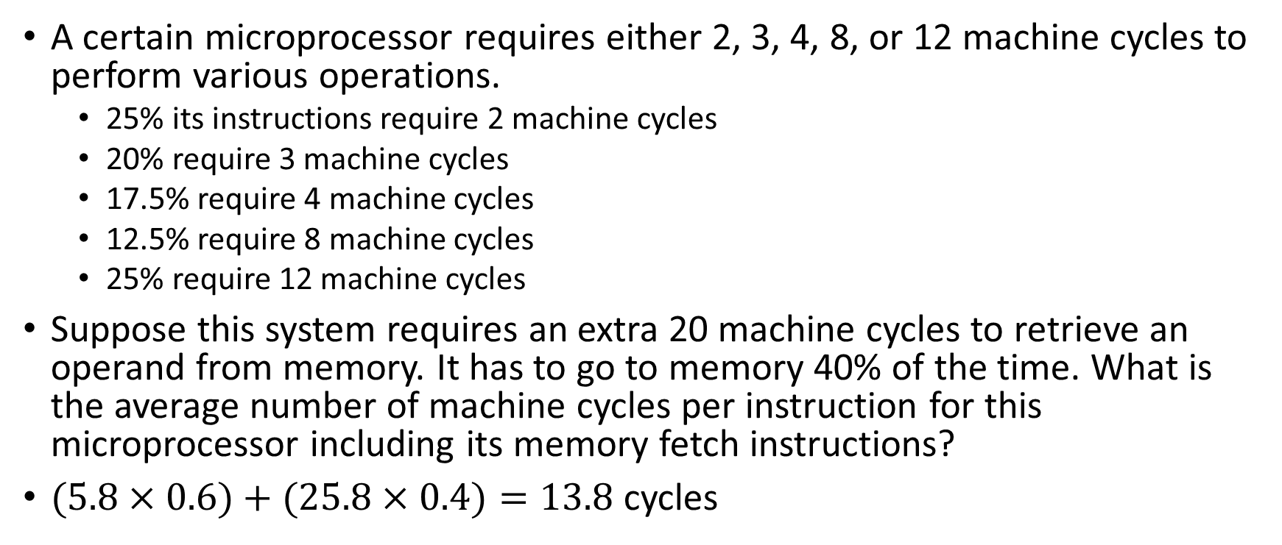
CPU Performance: Example
A certain microprocessor requires either 2, 3, 4, 8, or 12 machine cycles to perform various operations.
25% its instructions require 2 machine cycles
20% require 3 machine cycles
17.5% require 4 machine cycles
12.5% require 8 machine cycles
25% require 12 machine cycles
Suppose this system requires an extra 20 machine cycles to retrieve an operand from memory. It has to go to memory 40% of the time. What is the average number of machine cycles per instruction for this microprocessor including its memory fetch instructions?
$(5.8×0.6)+(25.8×0.4)=13.8$cycles

Slide 22
Benchmarking
In an effort to describe performance independent of clock speed and ISAs, a number of synthetic benchmarks have been attempted over the years.
These benchmarking programs exist only to produce performance numbers.
The earliest synthetic benchmarks were relatively small programs that were easy to optimize, which limited their usefulness.
These programs are much too small to be useful in evaluating the performance of today’s systems.
Also, software or hardware vendors can attempt to game the system by creating products whose performance stacks up well against well-known benchmarks
Then vendors can advertise their systems as being “superior” to others because of high benchmark scores.
This is known pejoratively as benchmarketing

Slide 23
Benchmarking: SPEC CPU2017
In 1988 the Standard Performance Evaluation Corporation (SPEC) was formed to address the need for objective benchmarks.
SPEC produces benchmark suites for various classes of computers and computer applications.
Their most widely known benchmark suite is the SPEC CPU benchmark.
The SPEC CPU2017 benchmark consists of 43 benchmarks, organized into four suites: two involving integer-only arithmetic, and two involving floating-point arithmetic
See www.spec.org/cpu2017 for the details
The benchmarks themselves cover a variety of application domains: image manipulation, video compression, artificial intelligence, route planning, molecular dynamics, 3D rendering and animation, physics simulations, others

Slide 24
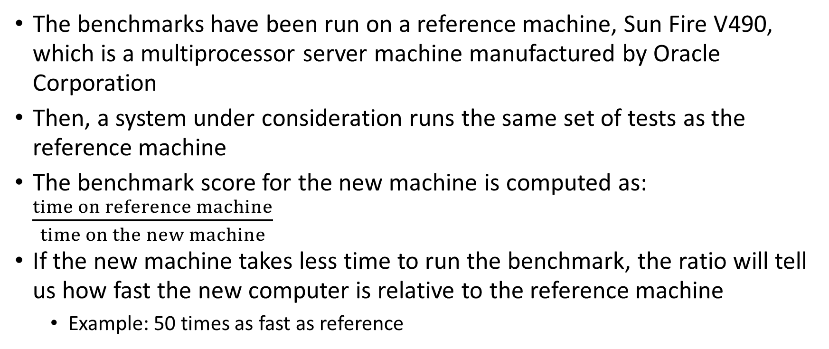
Benchmarking: SPEC CPU2017
The benchmarks have been run on a reference machine, Sun Fire V490, which is a multiprocessor server machine manufactured by Oracle Corporation
Then, a system under consideration runs the same set of tests as the reference machine
The benchmark score for the new machine is computed as: $\frac{time on reference machine}{time on the new machine}$
If the new machine takes less time to run the benchmark, the ratio will tell us how fast the new computer is relative to the reference machine
Example: 50 times as fast as reference

Slide 25
Benchmarking: SPEC CPU2017
Each CPU2017 benchmark takes about 5 minutes to run on a modern machine, meaning that running all four of the suites will take at least several hours
Manufacturers sometimes report two sets of numbers: The peak and base numbers are the results with and without certain software optimizations enabled, respectively.
Specifically, the peak numbers indicate performance when certain compiler optimizations are enabled
The SPEC CPU benchmark evaluates only CPU performance.
When the performance of the entire system under high transaction loads is a greater concern, the Transaction Performance Council (TPC) benchmarks are more suitable.

Slide 26
Benchmarking: TPC-C
The current version of the TPC testing suite is the TPC-C benchmark.
TPC-C models the transactions typical of a warehousing and distribution business using terminal emulation software (i.e., it simulates a sales clerk or other person using the system in a typical manner).
The TPC-C metric is the number of new warehouse order transactions per minute (tpmC), while a mix of other transactions is concurrently running on the system.
The tpmC result is divided by the total cost of the configuration tested to give a price-performance ratio.
e.g., the $tpmC for a $90,000 system that performs 15,000 tpm is $6tpmC
The price of the system includes all hardware, software, and maintenance fees that the customer would expect to pay.

Slide 27
Benchmarking: TPC
The Transaction Performance Council has also devised benchmarks for decision support systems (used for applications such as data mining) and for Web-based e-commerce systems.
For all of the TPC benchmarks, the systems tested must be available for general sale at the time of the test and at the prices cited in a full disclosure report.
Results of the tests are audited by an independent auditing firm that has been certified by the TPC.
TPC benchmarks are a kind of simulation tool.
They can be used to optimize system performance under varying conditions that occur rarely under normal conditions.
The simulation lets us reproduce situations that are otherwise hard to “force” to happen in reality, so that we can improve system performance.

Slide 28
Benchmarking
Simulation tools can also be devised to assess performance of an existing system, or to model the performance of systems that do not yet exist.
One of the greatest challenges in creation of a system simulation tool is in coming up with a realistic workload.
To determine the workload for a particular system component, system traces are sometimes used.
Traces are gathered by using hardware or software probes that collect detailed information concerning the activity of a component of interest (e.g., the CPU caches).
Because of the enormous amount of detailed information collected by probes, they are usually engaged for only a few seconds.
Several trace runs may be required to obtain statistically useful system information.

Slide 29
Benchmarking
Devising a good simulator requires that one keep a clear focus as to the purpose of the simulator
A model that is too detailed is costly and time-consuming to write.
Conversely, it is of little use to create a simulator that is so simplistic that it ignores important details of the system being modeled.
A simulator should be validated to show that it is achieving the goal that it set out to do: a simple simulator is easier to validate than a complex one.

Slide 30
Disk Performance
Optimal disk performance is critical to system throughput.
Disk drives are the slowest memory component, with the fastest access times one million times longer than main memory access times.
A slow disk system can choke transaction processing and drag down the performance of all programs when virtual memory paging is involved.
Low CPU utilization can actually indicate a problem in the I/O subsystem, because the CPU spends more time waiting than running.
Disk utilization is the measure of the percentage of the time that the disk is busy servicing I/O requests.
It gives the probability that the disk will be busy when another I/O request arrives in the disk service queue.

Slide 31
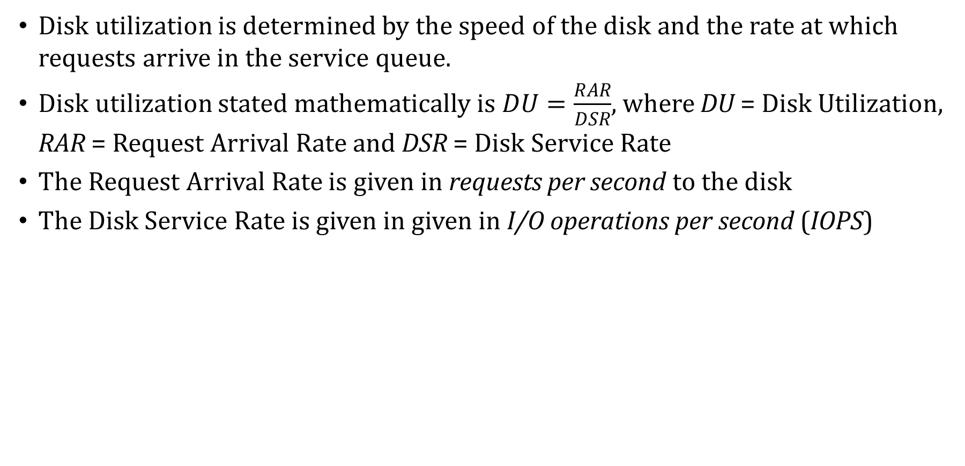
Disk Performance
Disk utilization is determined by the speed of the disk and the rate at which requests arrive in the service queue.
Disk utilization stated mathematically is $DU=\frac{RAR}{DSR}$, where DU = Disk Utilization, RAR = Request Arrival Rate and DSR = Disk Service Rate
The Request Arrival Rate is given in requests per second to the disk
The Disk Service Rate is given in given in I/O operations per second (IOPS)

Slide 32
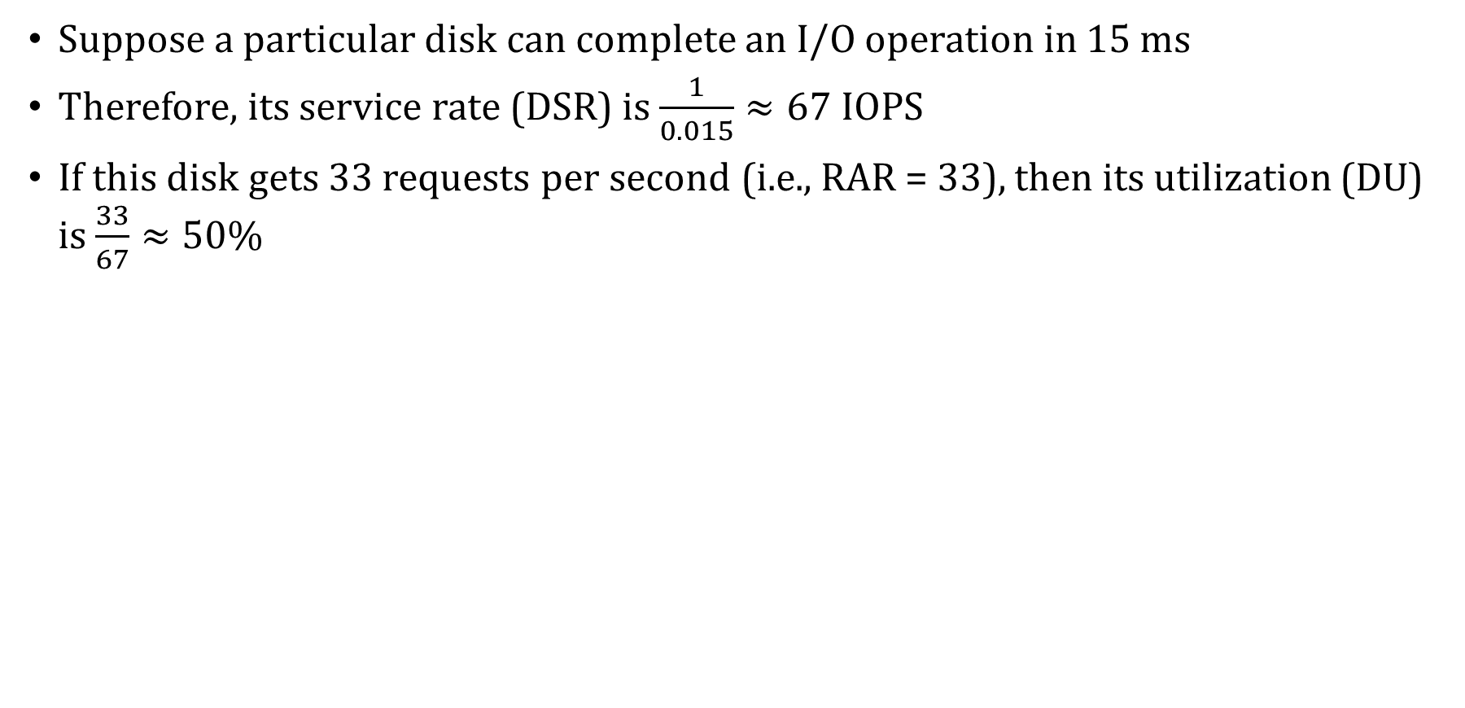
Disk Performance: Example #1
Suppose a particular disk can complete an I/O operation in 15 ms
Therefore, its service rate (DSR) is$\frac{1}{0.015}≈67$ IOPS
If this disk gets 33 requests per second (i.e., RAR = 33), then its utilization (DU) is $\frac{33}{67}≈50\%$

Slide 33
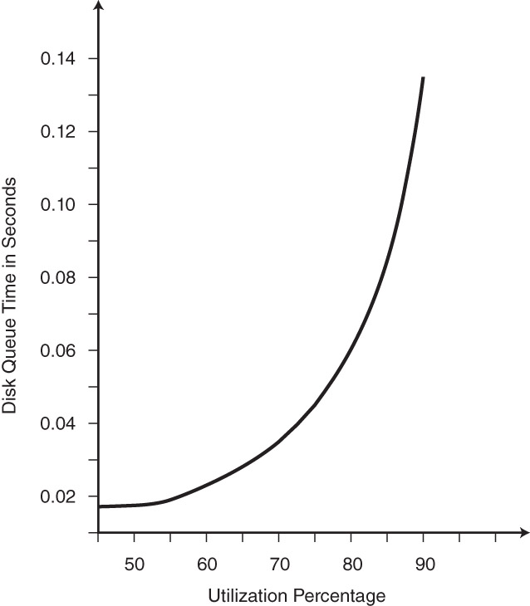
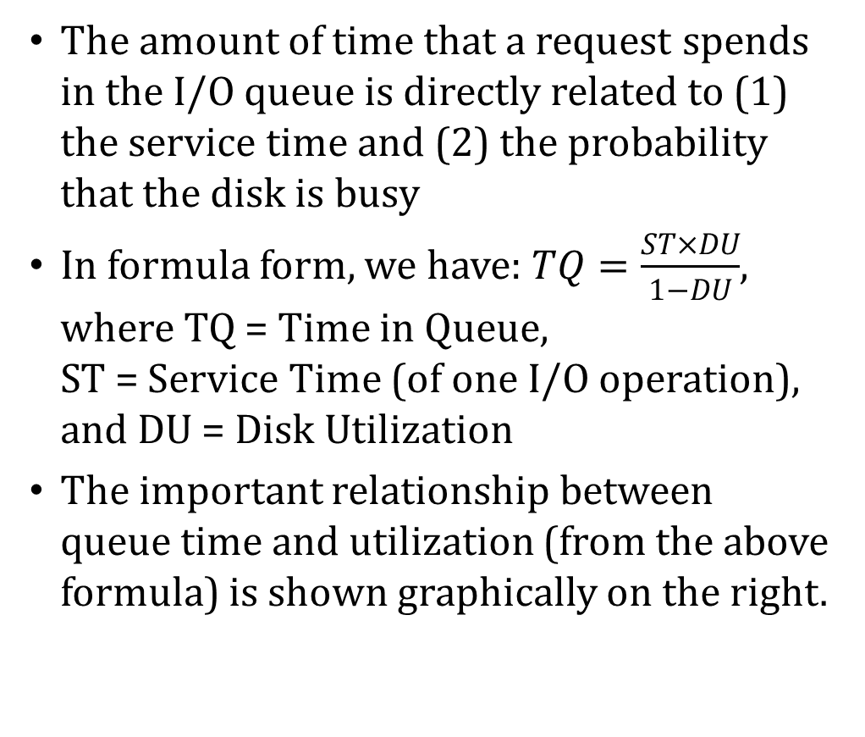
Disk Performance
The amount of time that a request spends in the I/O queue is directly related to (1) the service time and (2) the probability that the disk is busy
In formula form, we have: $TQ=\frac{ST×DU}{1−DU}$, where TQ = Time in Queue, ST = Service Time (of one I/O operation), and DU = Disk Utilization
The important relationship between queue time and utilization (from the above formula) is shown graphically on the right.

Slide 34
Disk Performance
The “knee” of the curve is around 78%. This is why 80% is the rule-of-thumb upper limit for utilization for most disk drives.
Beyond that, queue time quickly becomes excessive.

Slide 35
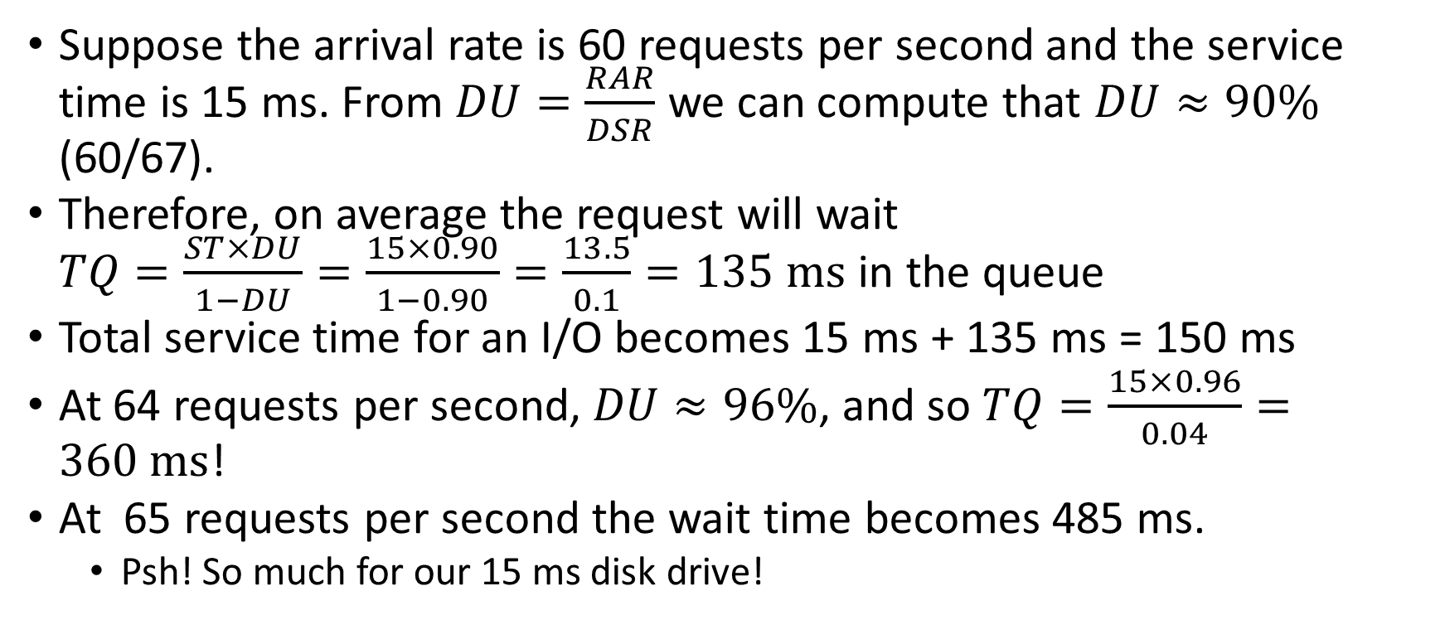
Disk Performance: Example #2
Suppose the arrival rate is 60 requests per second and the service time is 15 ms. From $DU=\frac{RAR}{DSR}$ we can compute that $DU≈90\%$ (60/67).
Therefore, on average the request will wait $TQ=\frac{ST×DU}{1−DU}=\frac{15×0.90}{1−0.90}=\frac{13.5}{0.1}=135 ms$ in the queue
Total service time for an I/O becomes 15 ms + 135 ms = 150 ms
At 64 requests per second, $DU≈96\%$, and so $TQ=\frac{15×0.96}{0.04}=360 ms$!
At 65 requests per second the wait time becomes 485 ms.
Psh! So much for our 15 ms disk drive!

Slide 36
Disk Performance
The manner in which files are organized on a disk greatly affects throughput.
Disk arm motion is the greatest consumer of service time.
Disk specifications cite average seek time, which is usually in the range of 5 to 10 ms.
However, a full-stroke seek (moving the disk arm from the innermost track to the outermost, or vice versa) can take as long as 15 to 20 ms.
Clever disk scheduling algorithms endeavor to minimize seek time.

Slide 37
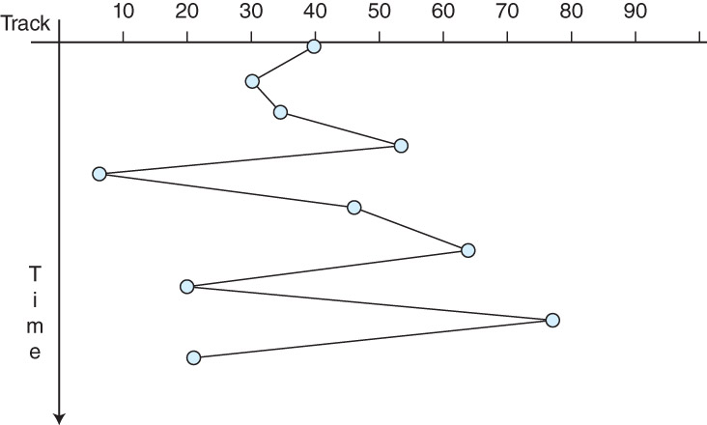
Disk Scheduling: FCFS
The most naïve disk scheduling policy is first-come, first-served (FCFS).
As its name implies, FCFS services all I/O requests in the order in which they arrive in the queue.
With this approach, there is no real control over arm motion, so random, wide sweeps across the disk are possible (see figure).
Using FCFS, performance is unpredictable and widely variable.

Slide 38
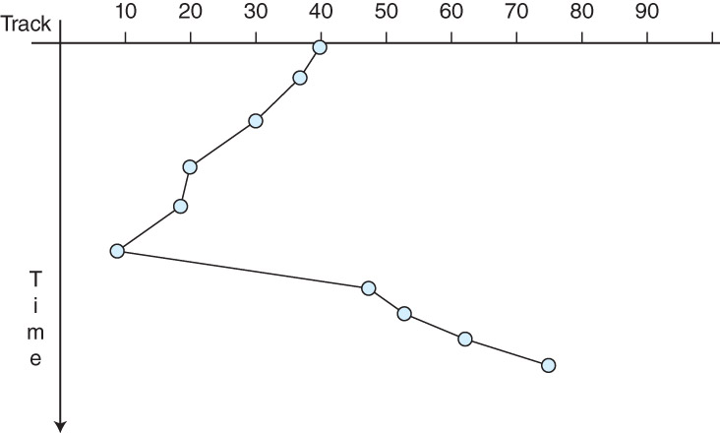
Disk Scheduling: SSTF
Arm motion is reduced when requests are ordered so that the disk arm moves only to the track nearest its current location.
This is the idea employed by the shortest seek time first (SSTF) scheduling algorithm.
Disk track requests are queued and selected so that the minimum arm motion is involved in servicing the request (see figure).

Slide 39
Disk Scheduling: SSTF
With SSTF, starvation is possible: A track request for a “remote” track could keep getting shoved to the back of the queue nearer requests are serviced.
To avoid starvation, fairness can be enforced by having the disk arm continually sweep over the surface of the disk, stopping when it reaches a track for which it has a request.
This approach is called an elevator algorithm.

Slide 40
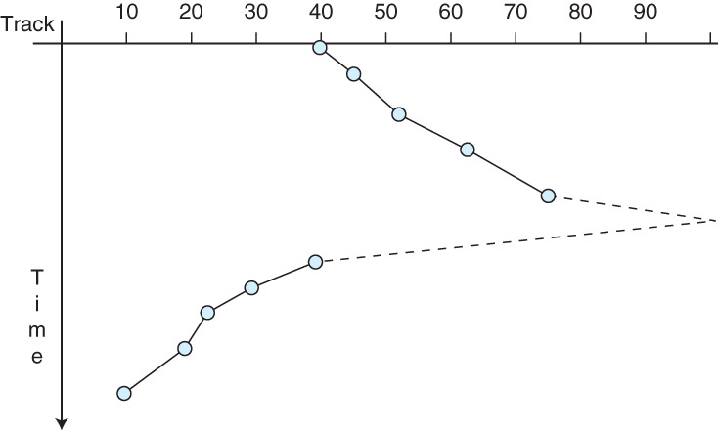
Disk Scheduling: SCAN
In the context of disk scheduling, the elevator algorithm is known as SCAN (which is not an acronym).
While SCAN entails a lot of arm motion, the motion is constant and predictable.
Moreover, the arm changes direction only twice: at the center and at the outermost edges of the disk (see figure).

Slide 41
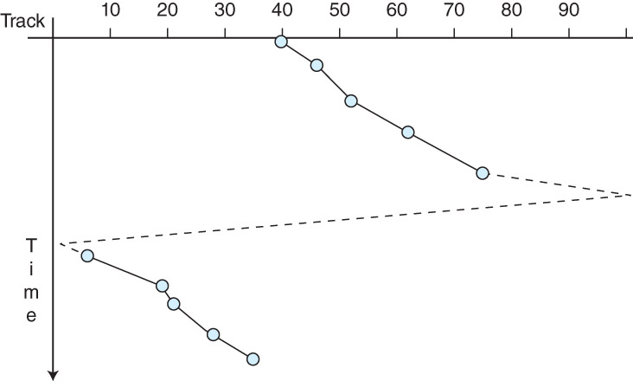
Disk Scheduling: C-SCAN
A SCAN variant, called C-SCAN for circular SCAN, treats track zero as if it is adjacent to the highest-numbered track on the disk.
The arm moves in one direction only, providing a simpler SCAN implementation.
The figure on the right illustrates a series of read requests where after track 75 is read, the arm passes to track 99, and then to track 0, from which it starts reading the lowest-numbered tracks, starting with track 6.

Slide 42
Disk Scheduling: C-SCAN
The motivation for C-SCAN might not be clear
Consider the arm’s movement in regular SCAN as it “turns around” and heads back in the other direction
It is likely to not be processing many I/O requests initially because it just passed over those tracks
Also, the tracks at the opposite edge of the platter now have a long wait to be serviced
C-SCAN solves both of these problems and reduces the amount of variance in how long it takes for the disk to service I/O requests

Slide 43
Disk Scheduling: LOOK
The disk arm motion of SCAN and C-SCAN can be reduced through the use of the LOOK and C-LOOK algorithms.
Instead of sweeping the entire disk, the disk arm travels only to the highest- and lowest-numbered tracks for which access requests are pending.
Although the circuitry is more complex, LOOK and C-LOOK provide the best theoretical throughput, although the circuitry is the most complex.

Slide 44
Disk Scheduling: Example #1
In what order would the hard disk tracks 23, 95, 44, 42, 76, 71, 55 be visited using the FCFS algorithm? Assume each platter of the disk has 100 tracks numbered 0 through 99. At the time the first request arrives in the disk request queue, the read/write head is at track 50, moving toward higher-numbered tracks.
Answer: 23, 95, 44, 42, 76, 71, 55

Slide 45
Disk Scheduling: Example #2
In what order would the hard disk tracks 23, 95, 44, 42, 76, 71, 55 be visited using the SSTF algorithm? Assume each platter of the disk has 100 tracks numbered 0 through 99. At the time the first request arrives in the disk request queue, the read/write head is at track 50, moving toward higher-numbered tracks.
Answer: 55, 44, 42, 23, 71, 76, 95

Slide 46
Disk Scheduling: Example #3
In what order would the hard disk tracks 23, 95, 44, 42, 76, 71, 55 be visited using the SCAN algorithm? Assume each platter of the disk has 100 tracks numbered 0 through 99. At the time the first request arrives in the disk request queue, the read/write head is at track 50, moving toward higher-numbered tracks. Indicate when the head arrives at track 0 and/or track 99.
Answer: 55, 71, 76, 95, (99), 44, 42, 23

Slide 47
Disk Scheduling: Example #4
In what order would the hard disk tracks 23, 95, 44, 42, 76, 71, 55 be visited using the C-SCAN algorithm? Assume each platter of the disk has 100 tracks numbered 0 through 99. At the time the first request arrives in the disk request queue, the read/write head is at track 50, moving toward higher-numbered tracks. Indicate when the head arrives at track 0 and/or track 99.
Answer: 55, 71, 76, 95, (99), (0), 23, 42, 44

Slide 48
Disk Scheduling: Example #5
In what order would the hard disk tracks 23, 95, 44, 42, 76, 71, 55 be visited using the LOOK algorithm? Assume each platter of the disk has 100 tracks numbered 0 through 99. At the time the first request arrives in the disk request queue, the read/write head is at track 50, moving toward higher-numbered tracks.
Answer: 55, 71, 76, 95, 44, 42, 23

Slide 49
Disk Scheduling: Example #6
In what order would the hard disk tracks 23, 95, 44, 42, 76, 71, 55 be visited using the C-LOOK algorithm? Assume each platter of the disk has 100 tracks numbered 0 through 99. At the time the first request arrives in the disk request queue, the read/write head is at track 50, moving toward higher-numbered tracks.
Answer: 55, 71, 76, 95, 23, 42, 44

Slide 50
Optimizing Disk Performance
At high utilization rates, SSTF performs slightly better than SCAN or LOOK. But the risk of starvation persists.
Under very low utilization (under 20%), the performance of any of these algorithms will be acceptable.
No matter which scheduling algorithm is used, file placement greatly influences performance.
When possible, the most frequently-used files should reside in the center tracks of the disk (to reduce average access time), and the disk should be periodically defragmented.

Slide 51
Optimizing Disk Performance
The best way to reduce disk arm motion is to avoid using the disk as much as possible.
To this end, many disk drives, or disk drive controllers, are provided with cache memory or a number of main memory pages set aside for the exclusive use of the I/O subsystem.
Disk cache memory is usually associative.
Because associative cache searches are time-consuming, performance can actually be better with smaller disk caches because hit rates are usually low.

Slide 52
Optimizing Disk Performance
Many disk drive-based caches use prefetching to reduce disk accesses.
When using prefetching, a disk will read a number of sectors subsequent to the one requested with the expectation that one or more of the subsequent sectors will be needed “soon.”
Empirical studies have shown that over 50% of disk accesses are sequential in nature, and that prefetching increases performance by 40%, on average.
Prefetching is subject to cache pollution, which occurs when the cache is filled with data that no process needs, leaving less room for useful data.
Additionally, because disk caches serve as a staging area for data to be written to the disk, some disk cache management schemes evict all bytes after they have been written to the disk.

Slide 53
Optimizing Disk Performance
With cached disk writes, we are faced with the problem that cache is volatile memory: in the event of a massive system failure, data in the cache will be lost.
An application believes that the data has been committed to the disk, when it really is in the cache. If the cache fails, the data just disappears.
To defend against power loss to the cache, some disk controller-based caches are supplied with a battery backup.
Another approach to combating cache failure is to employ a write-through cache where a copy of the data is retained in the cache in case it is needed again “soon,” but it is simultaneously written to the disk.
The operating system is signaled that the I/O is complete only after the data has actually been placed on the disk.
With a write-through cache, performance is somewhat compromised to provide reliability.

Slide 54
Optimizing Disk Performance
When throughput is more important than reliability, a system may employ the write-back cache policy.
Some disk drives employ opportunistic writes.
With this approach, dirty blocks wait in the cache until the arrival of a read request for the same cylinder.
The write operation is then “piggybacked” onto the read operation.
Opportunistic writes reduce the performance on reads, but improve it for writes.
In conclusion, the tradeoffs involved in optimizing disk performance can present difficult choices, but the first goal is to assure data reliability and consistency.
No matter what its price, upgrading a disk subsystem is almost always cheaper than replacing lost data.

